Slide 1
UMD DATA
Challenge 21
Level 5: HUD Opportunity Zones

Slide 2




TEAM MEMBERS
MIDN 2/C Chase Lee
MIDN 2/C Brigitta Szepesi
MIDN 2/C Everett Stenberg
MIDN 2/C Caleb Williams

Slide 3
PROBLEM STATEMENT
United States Department of Housing and Urban Development (HUD)
Background
Data Considerations (Merging of Other Datasets)
Notes:
Background:
Opportunity Zones are a place-based incentive that were created by the Tax Cuts and Jobs Act of 2017. This incentive allows investors to allocate unrealized capital gains to invest in Qualified Opportunity Funds. States submitted their list of proposed designated Opportunity Zones to the Internal Revenue Service (IRS).
While the Department of Housing and Urban Development (HUD) has a great interest in Opportunity Zones, including Secretary Benjamin Carson chairing the White House Opportunity and Revitalization Council, Opportunity Zones are an IRS-administered program.
Data Considerations:
Using Python, Tableau, Excel, and the ArcGis Map Feature, we were able to perform successful analysis of the Opportunity Zones database
We did not remove any of the null values, we assigned them a False value since they still account for a large proportion of the dataset

Slide 4
Abstract
Notes:
Our team’s analysis of the Level 5 HUD data will analyze national and state trends among the Opportunity Zones. “Opportunities Zones are a place-based incentive that were created...to allocate unrealized capital gains to invest in Qualified Opportunity Funds.” We intend to analyze each census tract and determine the relationship between qualified low income communities and qualified Opportunity Zones across different demographic and socioeconomic indicators to predict shared characteristics that make them eligible. Furthermore, in assessing the relationships between the socioeconomic, housing, and demographic data we will evaluate which factor plays a more significant role in determining its status as a Qualified Opportunity Zone. This is for the purposes of predicting the deciding criteria for designated census tracts.
For our method we are using Tableau and Python as our main visualising software and analysis tool for the specific socioeconomic trends and we hope to see positive correlation between census tracts that give an indication of LIC characteristics and the likelihood of those same census tracts falling under Qualified Opportunity Zones. In doing so, we are trying to estimate what makes a census tract eligible. The IRS has not released these criteria, so it would be very interesting to see what patterns are observable.

Slide 5
Research Methodology

Slide 6
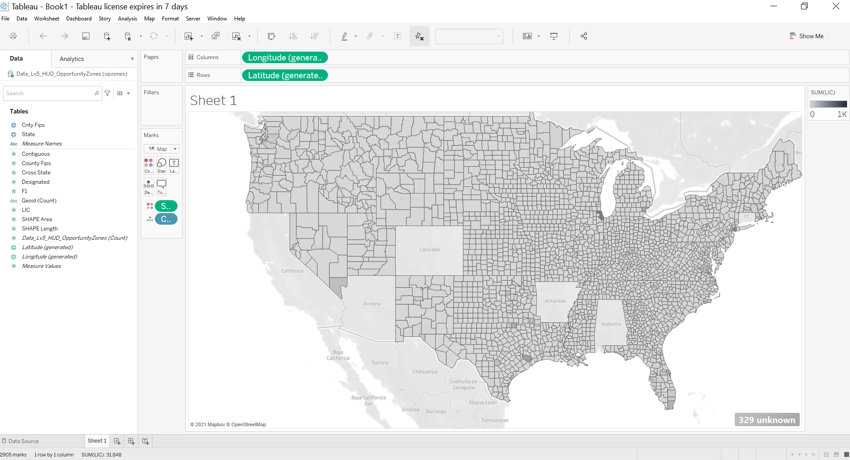
Tableau
Notes:
Tableau Software is an American interactive data visualization software company
It was relatively intuitive in terms of producing results using the demographic information we were given

Slide 7
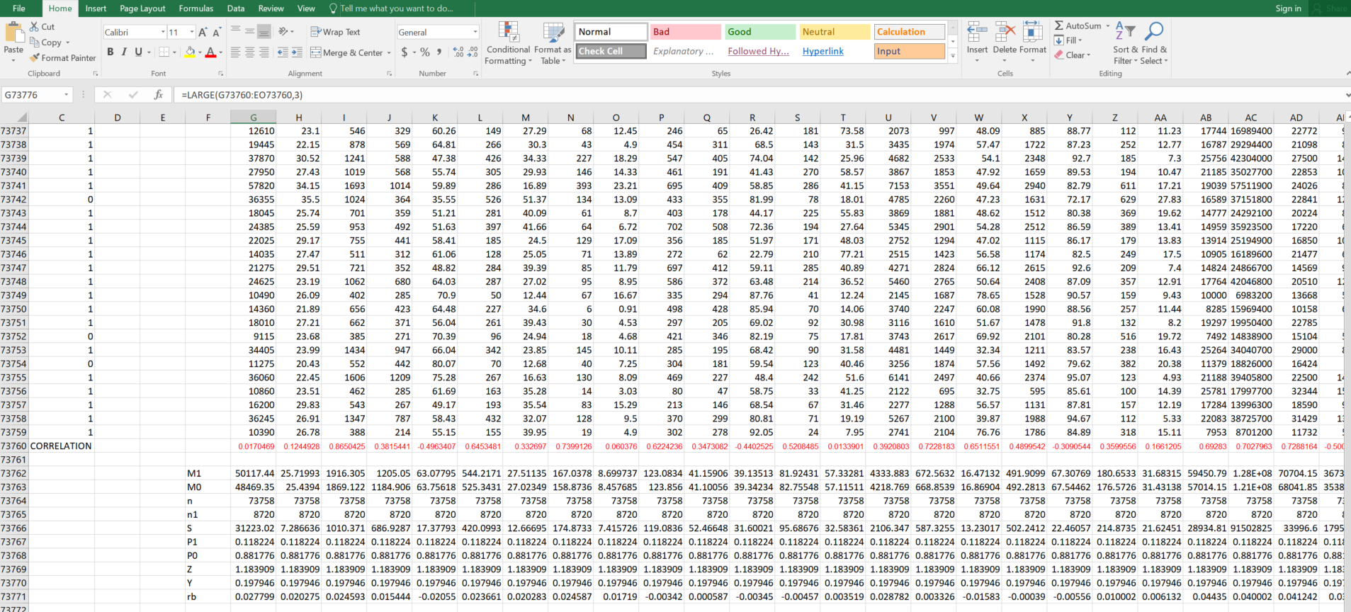
Excel
Notes:
Microsoft Excel is a spreadsheet developed by Microsoft for Windows
It features calculation, graphing tools, pivot tables, and a macro programming language called Visual Basic for Applications.
We used the language in order to manipulate the data
We sorted the GEOID to align the different databases.

Slide 8
Findings
Notes:
We broke up our findings into specific phases:
Analyzing the relationship between the qualified low incomes communities and their corresponding demographic area
Analyzing the relationship between the qualified Opportunity Zones and their corresponding demographic area
Assessing the relationships between the socioeconomic, housing, and demographic data to determine which plays the most pivotal role in evaluating a Qualified Opportunity Zone

Slide 9
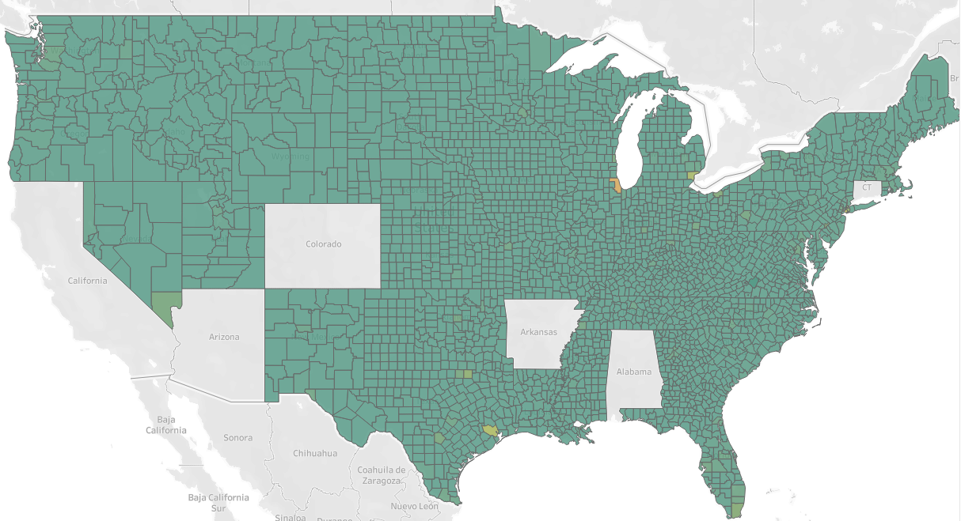

Qualified Low Income Communities
Notes:
We can identify from the geographic map that there are very few counties/districts that actually qualify as Low Income Communities.
Additionally, we can recognize from the visual representation of the database that some counties were regarded to a higher degree as Low income Communities. The database provided records of each individual county and broke it down by tract.

Slide 10
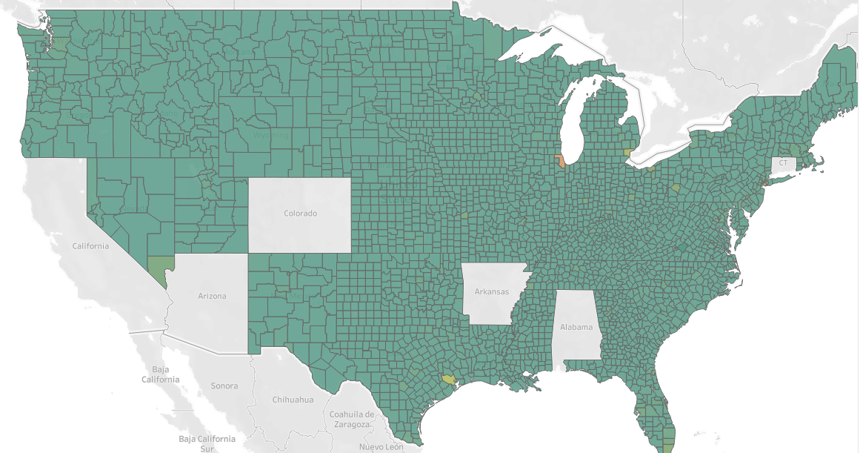
Qualified Opportunity Zones
Notes:
We can identify from the geographic map that there are very few counties/districts that actually qualify as Opportunity Zones. Majority of the Low income communities also qualified as opportunity zones. There is a very correlation between the two.

Slide 11
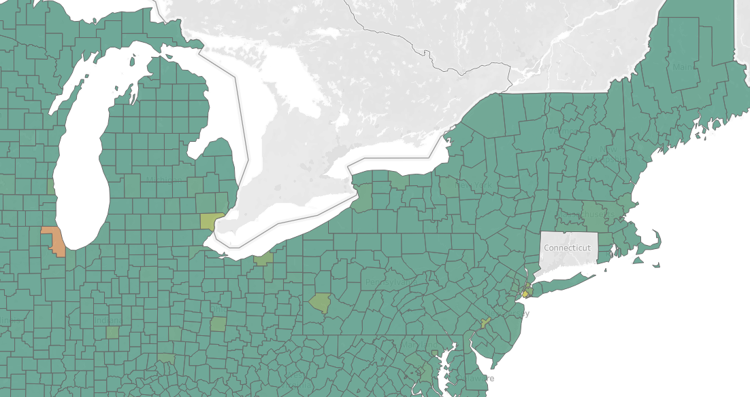
Qualified Opportunity Zones (North East Region)
Notes:
The most prevalent region that has opportunity zones is the North East region of the United States. They are dispersed and to some greater/lesser extents depending on the contiguous counties.

Slide 12

Pearson’s R of LIC and OZ
r = 0.401568187
Notes:
The Pearson product-moment correlation coefficient, also known as r, is a measure of the strength and direction of the linear relationship between two variables

Slide 13
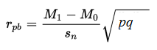
Point-Biserial
Correlation Coefficient (PBCC)
M₁ = mean (for the entire test) of the group that received the positive binary variable (i.e. the “1”).
M₀ = mean (for the entire test) of the group that received the negative binary variable (i.e. the “0”).
S_{n} = standard deviation for the entire test.
p = Proportion of cases in the “0” group.
q = Proportion of cases in the “1” group.
Notes:
The point biserial correlation coefficient, rpbi, is a special case of Pearson’s correlation coefficient. It measures the relationship between two variables:
One continuous variable
One naturally binary variable.
We found the Point-Biserial Correlation Coefficient using Excel
Like other correlation coefficients, the point biserial ranges from 0 to 1, where 0 is no relationship and 1 is a perfect relationship.

Slide 14
PBCC: Socioeconomic Findings
Number One Correlation (r_{pb} = 0.951623453):
Population ages 25 to 64
Number One Correlation (r_{pb} = 0.866827464):
Number of Households with 1 or more occupants per room
Number Three Correlation (r_{pb} = 0.865042512):
Total Workers Traveling to Work
Notes:
We compared the Qualified Opportunity Zones as the binary variable and the various categories as the continuous variables

Slide 15
PBCC: Housing Findings
Number One Correlation (r_{pb} = 0.9917721):
Median Value for Units with a Mortgage
Number One Correlation (r_{pb} = 0.9445041):
Median Value for Units without a Mortgage
Number Three Correlation (r_{pb} = 0.935672):
Occupied Housing Units

Slide 16
PBCC: Demographic Findings
Number One Correlation (r_{pb} = 0.05532185):
Asian Alone (not Hispanic)
Number One Correlation (r_{pb} = 0.052796186):
Asian Alone (not Hispanic) as a %
Number Three Correlation (r_{pb} = 0.02499059):
Population ages 35 to 44 having a Graduate Degree

Slide 17
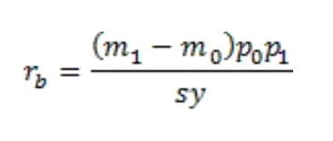
Biserial Correlation Coefficient
(BCC)
n₀ = number of elements in X which are 0
n₁ = the number of elements in X which are 1
p₀ = n₀/n
p₁ = n₁/n
m₀ = the mean of {y_{i}: x_{i} = 0},
m₁ = the mean of {y_{i}: x_{i} = 1},
s is the population standard deviation of Y
y = NORM.S.DIST(NORM.S.INV(p₀),FALSE)
Notes:
The biserial correlation coefficient is also a correlation coefficient where one of the samples is measured as dichotomous. In such cases, the point-biserial correlation generally under-reports the true value of the association. The biserial correlation coefficient provides a better estimate in this case.

Slide 18
BCC: Socioeconomic Findings
Number One Correlation (r_{b} = 0.065383014):
Earning More Than $35,000 paying > 30%
Number One Correlation (r_{b} = 0.064192097):
Renter Occupied Earning More than $35,000 paying > 30%
Number Three Correlation (r_{b} = 0.06399143):
Earning More Than $35,000 paying > 30% (as a %)

Slide 19
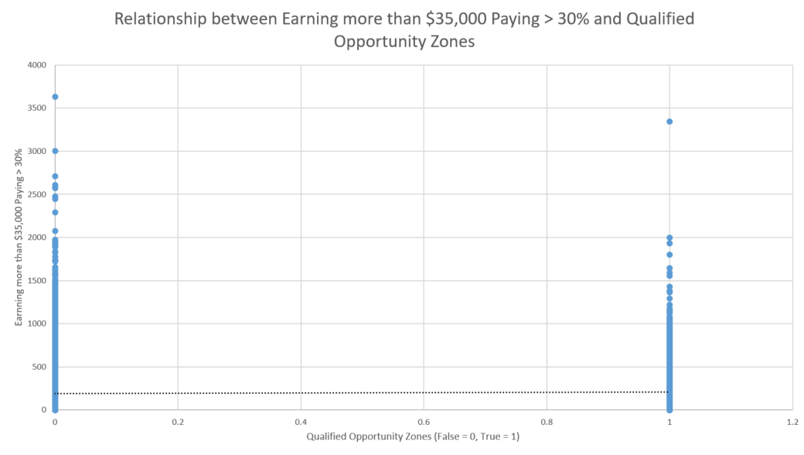
Socioeconomic: Number One Relationship

Slide 20
BCC: Housing Findings
Number One Correlation (r_{b} = 0.105697704):
Median Value for Units with a Mortgage
Number One Correlation (r_{b} = 0.105444849):
Median Value of Owner-Occupied Housing Units
Number Three Correlation (r_{b} = 0.100229186):
Median Value for Units without a Mortgage

Slide 21
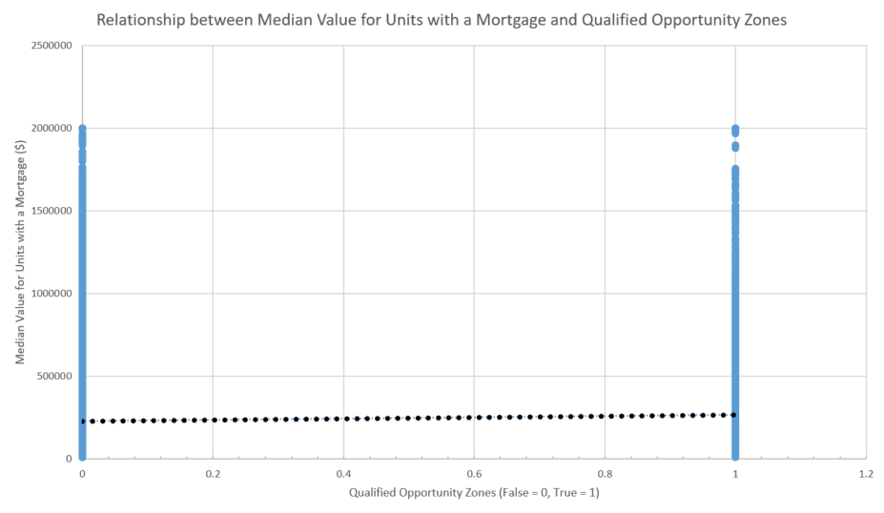
Housing: Number One Relationship

Slide 22
BCC: Demographic Findings
Number One Correlation (r_{b} = 0.09023812):
Asian Alone (not Hispanic)
Number One Correlation (r_{b} = 0.086118377):
Asian Alone (not Hispanic) as a %
Number Three Correlation (r_{b} = 0.040763343):
Population ages 35 to 44 having a Graduate Degree

Slide 23
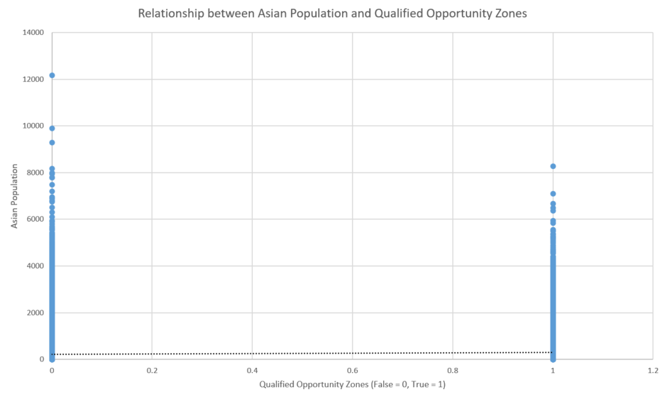
Demographic: Number One Relationship

Slide 24
IMPLICATIONS
Beneficial to the Department of Housing and Urban Development regarding the indicators that impacted the qualifications to be an Opportunity Zone
Beneficial to the IRS to determine which factors will likely play a pivotal role regarding the future of potential Opportunity Zones

Slide 25
Questions?

